Slide 1
Disney’s Bambi

Slide 2
Animation Process
“To retain the charm of these creatures, our… drawings must fully capture the natural movements and attitudes of living animals.” –Walt Disney
Two fawns were brought to the animation studio for animators to study
Studied film of animals in the wilderness in Maine
Animator Marc Davis
Studied the expressions and behaviors of human babies and adapted them onto deer

Slide 3
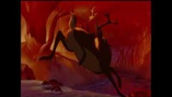
Tyrus Wong-an ”inbetweener”
Working on Pinocchio, not Bambi
Minimalist approach, less hyperrealistic
Vivid colors, expressionist

Slide 4
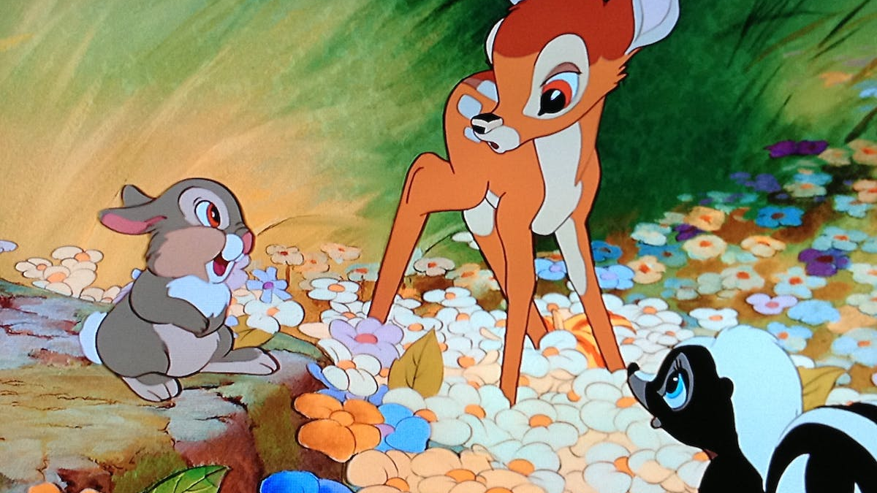
Effective Anthropomorphism
Used human facial features and behaviors, but animal body language to effectively anthropomorphize forest creatures
Make them more sympathetic for humans, but also realistic caricatures of animals
“They worked out the essence of Disney animation on Bambi, that’s continued to this day, which is animals who are caricatures of human beings and at the same time move and behave like animals… The art of animation never was the same again.” - Film historian John Culhane

Slide 5
Novel vs Disney Adaptation
“Salten’s world is more realistically complex, exploring ecological relationships like starvation and predation. People are problematic, but not evil, in his tale. Disney’s version, on the other hand, has ‘artistic elegance’ but also ‘ecological shallowness.”
While both the novel and the film portray the cycles of life and nature, the film places more emphasis upon death and life between animals
Not just deaths inflicted by humans

Slide 6
Cultural Impact (Then)
“the American nature lobby may have more in common with the readers of Aesop than with Darwinians”
Hunters felt misrepresented by the film-saw it as a threat to their ability to keep hunting
Bolstered some environmentalism/conservation efforts/ideologies
Reinforced/created harmful sentiments about hunters and hunting

Slide 7
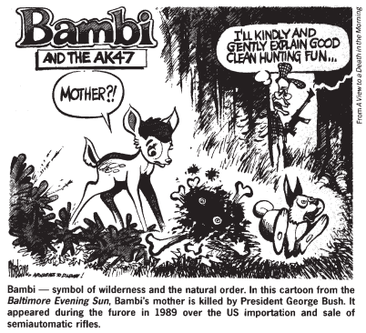
Cultural Impact (Now-ish)
Efforts to protect deer/wildlife for human pleasure/to avoid the upset of knowing an animal has died
2012: “naturalist Valerie Blaine blamed the Bambi Factor for the North Rutland Deer Alliance’s opposition to killing deer even to test for chronic wasting disease. According to Blaine, the group felt any herd reduction would spoil their “deer watching experience” in Chicago’s Northwest suburbs.”
Used to refer to the protection of innocence—gun control

Slide 8
Secondary Sources
https://www.acmi.net.au/stories-and-ideas/disney-how-bambi-changed-disneys-animation/
https://daily.jstor.org/the-trouble-with-bambi/
https://www.nature.com/articles/364111a0
https://www.whatitmeanstobeamerican.org/ideas/how-bambi-hoodwinked-american-environmentalists/#:~:text=Some%20of%20them%2C%20such%20as,became%20a%20rite%20of%20childhood.

